Slide 1

Update Situation
Fangzhou Chen
Jiacong Li
Marco Hoogesteger
Martijn Crombeen
Group 1

Slide 2
Contents
Meeting with Tom
Current situation

Slide 3
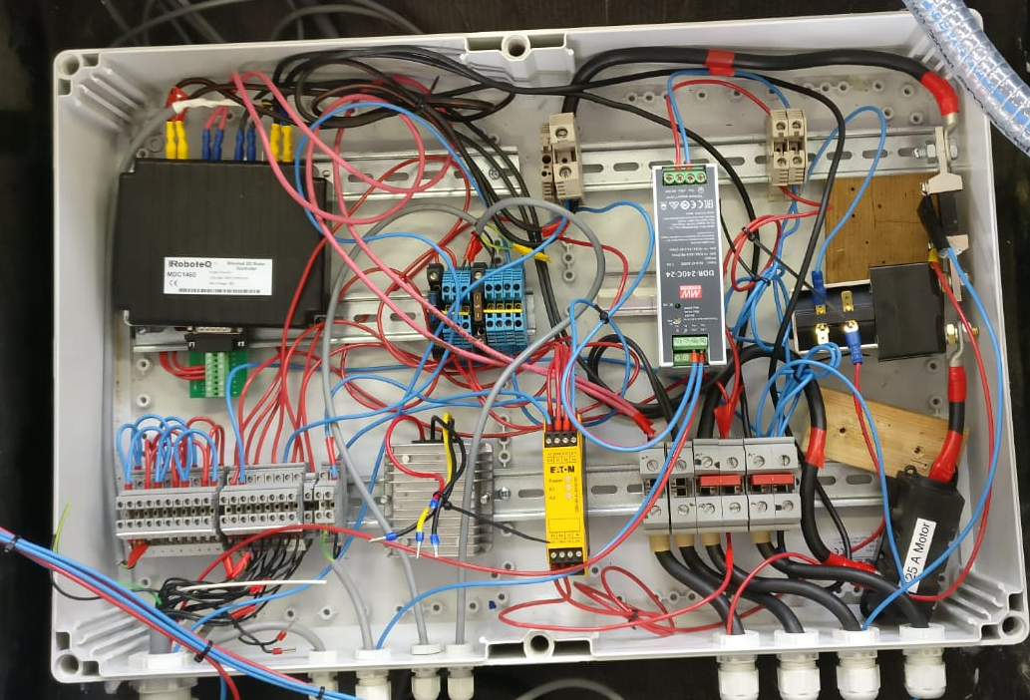
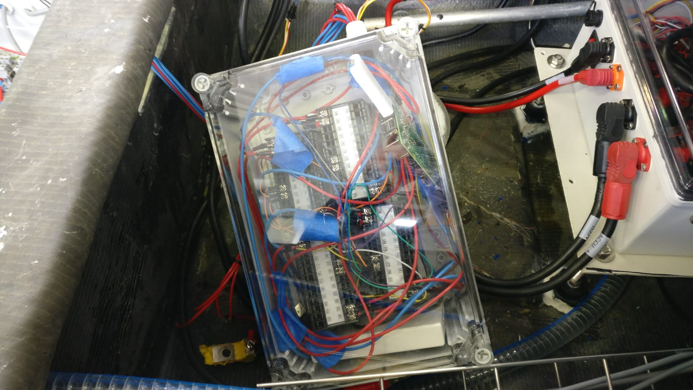
Meeting with Tom
Motor controller
Inner structure
Sensor box
Methods of measuring and recording
Methods of measuring and recording
Repair the sensor box and collect data from it.
Find the corresponding wires connected between the controller and the battery. Measure voltage on them with voltage meters. Record data with camera or Arduino when boat is sailing
Sensor box(broken)
Raspberry Pi

Slide 4
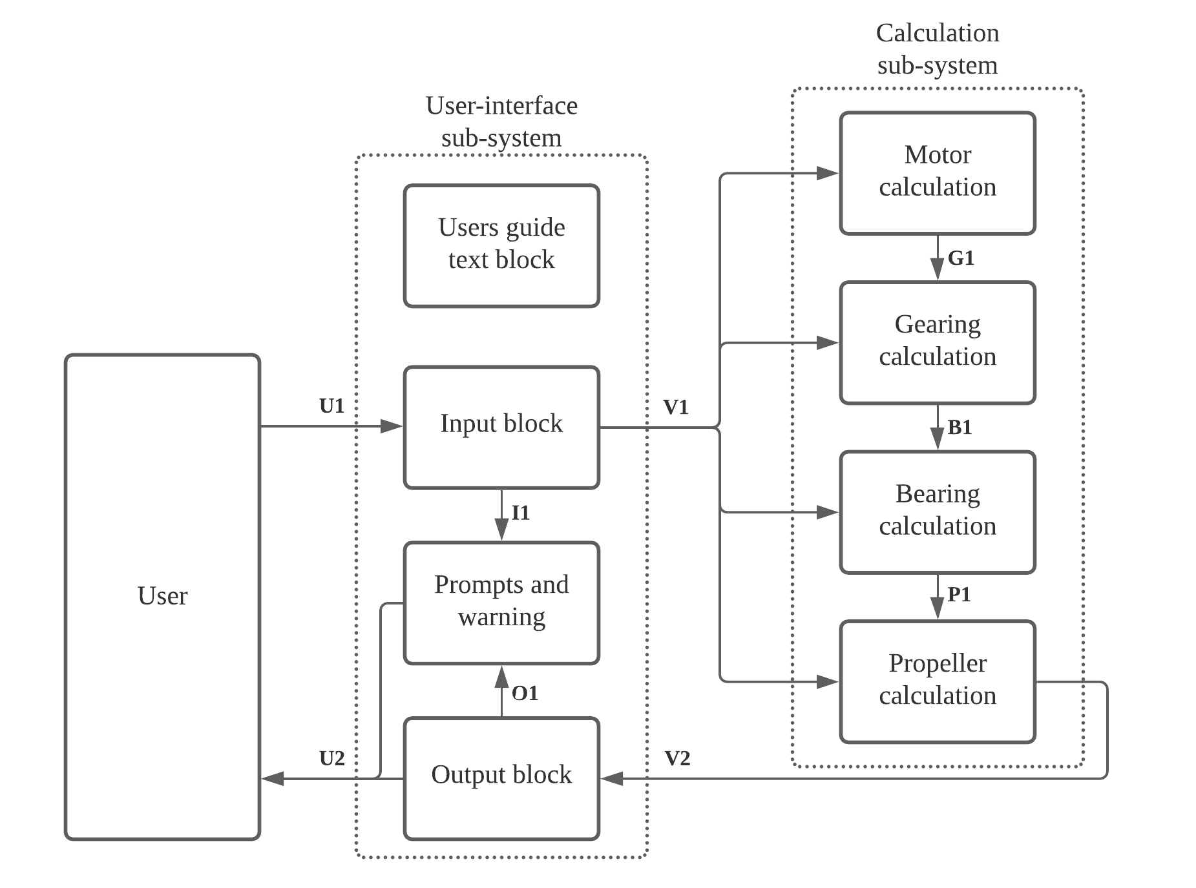
Current situation
Test plans of components are almost finished
Next step: Component integration: program in Excel.

Slide 5
Questions?
Thank you for your attention!

